Slide 1



Paal.ai - Smart Milk Detector
An iot-enabled milk quality monitoring system Using machine learning for real time Adulteration detection
Team Guide - Ms. V S Vetri Selvi
Presented By
B M BHARATH
D DARSHAN
E MOUNIKA

Slide 2


Problem Statement
Traditional milk quality tests are slow, costly, and not scalable. There’s a need for a real-time, cost-effective IoT-based system that uses sensor data and machine learning to accurately predict milk quality at scale.

Slide 3


Objective
Develop a cost-effective, portable device for real-time milk quality assessment using sensor technologies.
Critical Analysis:
Milk adulteration is a prevalent issue affecting consumer health.
Traditional quality assessment methods are time-consuming and expensive.
Recent advances in IoT and sensor integration offer automated, real-time monitoring solutions.

Slide 4
Literature Review
Durgun, M. (2024). Real-Time Milk Quality Control Using Multi-Spectral Sensing and Edge Computing: Advancing On-Site Detection of Milk Components with XGBoost. Applied Sciences, 14(23), 10916.
González, A. F., Laíño, R. B., Costa-Fernández, J. M., & Soldado, A. (2024). Progress and Challenge of sensors for Dairy Food Safety Monitoring. Sensors, 24(5), 1383.
Habsari, W., Udin, F., & Arkeman, Y. (2022). An analysis and design of fresh milk smart grading system based on internet of things. IOP Conference Series Earth and Environmental Science, 1063(1), 012059.
Kalaiarasi, G., Anandkumar, A., Kathirvelu, M., Dinakaran, K., & Ashok, J. (2022). IOT Based Milk Analyzer using Arduino with Wi-Fi Module. 2022 IEEE 2nd International Conference on Mobile Networks and Wireless Communications (ICMNWC), 1–5.
Lal, P. P., Prakash, A. A., Chand, A. A., Prasad, K. A., Mehta, U., Assaf, M. H., Mani, F. S., & Mamun, K. A. (2022). IoT integrated fuzzy classification analysis for detecting adulterants in cow milk. Sensing and Bio-Sensing Research, 36, 100486.
Machine Learning-Based Classification for milk Quality Assessment. (2025, February 5). IEEE Conference Publication | IEEE Xplore.
Çelik, A. (2022, December 31). Using machine learning algorithms to detect milk quality.
Mattar, H. L., Minim, L. A., Coimbra, J. S. R., Minim, V. P. R., Saraiva, S. H., & Telis-Romero, J. (2004). Modeling thermal conductivity, specific heat, and density of milk: a neural network approach. International Journal of Food Properties, 7(3), 531–539.
Mhapsekar, R. U., O’Shea, N., Davy, S., & Abraham, L. (2024). Hybrid Blended Deep Learning approach for milk quality analysis. IEEE Transactions on Emerging Topics in Computational Intelligence, 8(3), 2253–2268.
Saravanan, S., M, K., S, K. N., S, K. N., & V, N., I. (2021). Smart milk quality analysis and grading using IoT. 2022 6th International Conference on Intelligent Computing and Control Systems (ICICCS), 378–383.
An Edge-Centric industrial IoT solution for smart dairy processing. (2024, September 1). IEEE Journals & Magazine | IEEE Xplore.
An optimized neural network model to predict milk quality. (2024, January 18). IEEE Conference Publication | IEEE Xplore.
Development of IoT based sensor system for detection and identification of milk adulterants. (2024, March 18). IEEE Conference Publication | IEEE Xplore.
Empowering Dairy Farmers IoT milk Quality Monitoring devices. (2024, May 9). IEEE Conference Publication | IEEE Xplore.
Gehlot, A., Malik, P. K., Singh, R., Akram, S. V., & Alsuwian, T. (2022). Dairy 4.0: Intelligent Communication Ecosystem for the Cattle Animal Welfare with Blockchain and IoT Enabled Technologies. Applied Sciences, 12(14), 7316.
Manisha, N., & Jagadeeshwar, M. (2023). BC driven IoT-based food quality traceability system for dairy product using deep learning model. High-Confidence Computing, 3(3), 100121
Vishniakou, U. A., Al-Masri, A. H., & Al-Haji, S. K. (2021). Model and structure of the network internet of things for monitoring milk quality. «System Analysis and Applied Information Science», 1, 39–44.
Goyal, K., Kumar, P., & Verma, K. (2024). XAI-empowered IoT multi-sensor system for real-time milk adulteration detection. Food Control, 164, 110495.
Internet of Things (IoT) and Machine Learning (ML) enabled Livestock Monitoring. (2020, December 14). IEEE Conference Publication | IEEE Xplore.
Milk chain with ML & Blockchain: Revolutionizing Transparency for Ensuring Milk Purity in Dairy Industry. (2024, April 12). IEEE Conference Publication | IEEE Xplore.
DATASET
https://www.kaggle.com/datasets/cpluzshrijayan/milkquality

Slide 5
COMPonents USED
Arduino Uno R3 – Microcontroller for sensor interfacing
ESP8266 (NodeMCU) – Wi-Fi module for wireless data transmission
pH Sensor – Measures milk acidity
Temperature Sensor – Captures milk temperature
Load Cell with HX711 Module – Measures weight to help calculate milk density
Color Sensor – Evaluates milk color quality
OLED Display – Shows real-time milk quality grade on-site
Power Supply Module – Powers the system (battery or USB)
Connecting Wires, Breadboard, and Enclosure – For circuit assembly and protection

Slide 6
System Architecture
The IoT-enabled milk quality monitoring system consists of three main layers:
1. Data Acquisition Layer
2. Data Processing & Storage Layer
3. User Interaction Layer

Slide 7
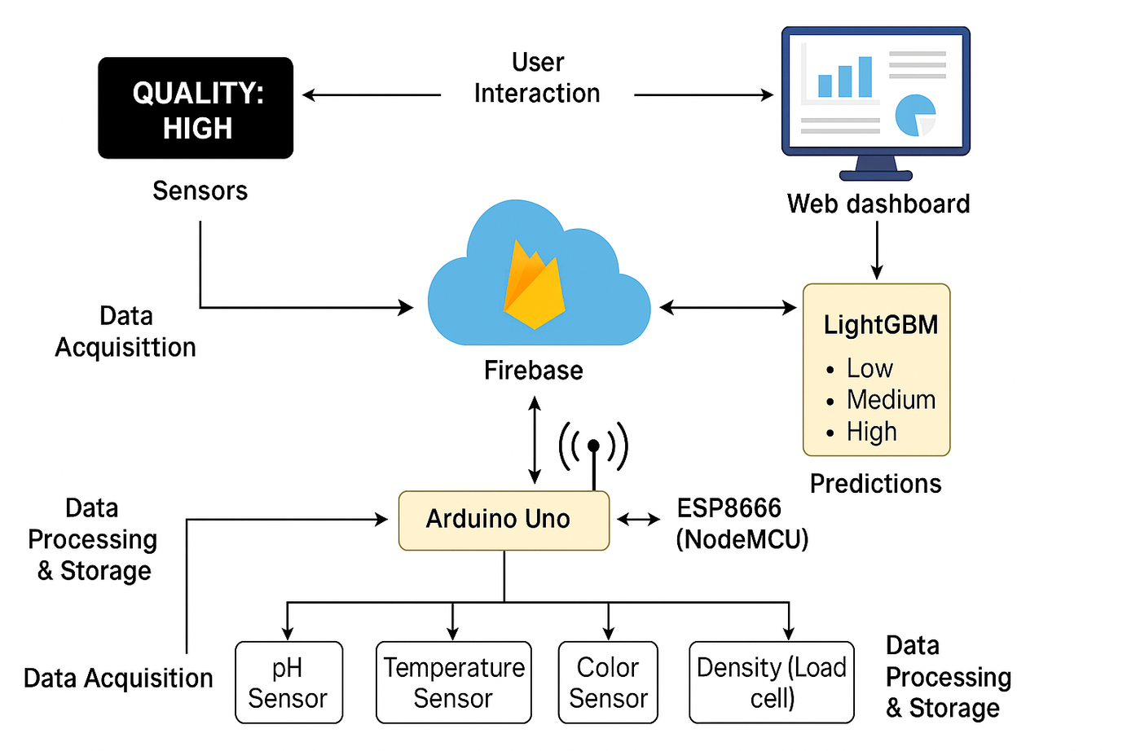

Slide 8
System Architecture
1. Data Acquisition Layer
Sensors: pH, Temperature, Color, and Load Cell
Microcontroller: Arduino Uno R3 collects sensor data
Wireless Module: ESP8266 (NodeMCU) transmits data to the cloud

Slide 9
System Architecture
2. Data Processing & Storage Layer
Cloud Platform: Firebase stores real-time sensor data
ML Integration: LightGBM model fetches data, predicts milk quality (Low, Medium, High), and sends results back to Firebase
Preprocessing: Feature scaling, outlier removal, and density calculation

Slide 10
System Architecture
3. User Interaction Layer
OLED Display: Real-time feedback for farmers
Web Dashboard: Remote monitoring and analytics for processors and regulators
Security: End-to-end encryption for safe data transmission and storage

Slide 11
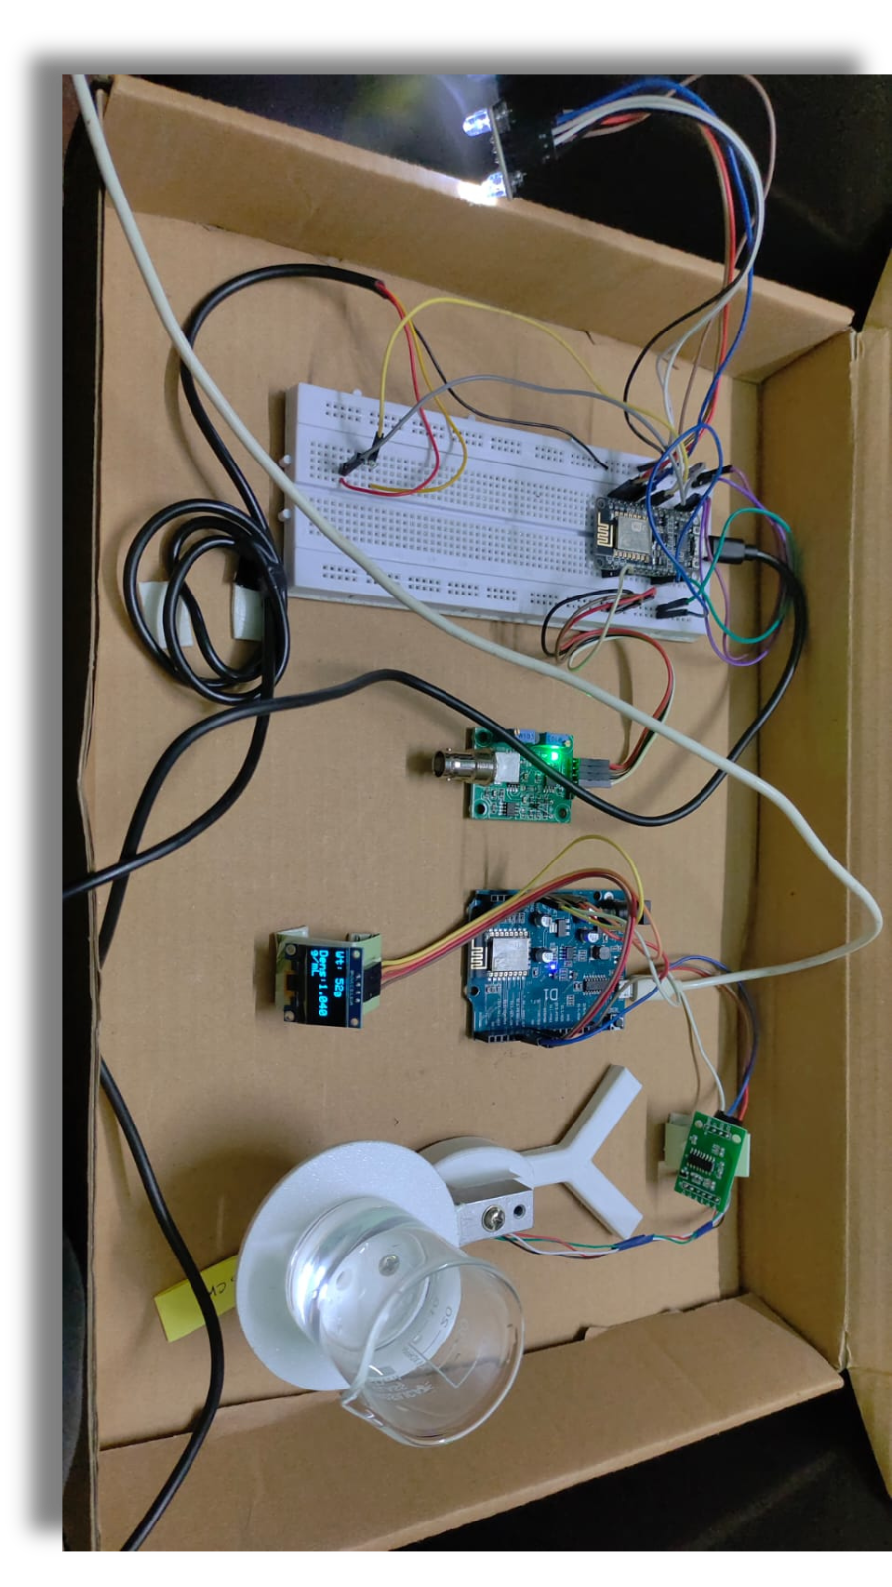

Slide 12
Build & working process
Module 1: Sensor Data Acquisition and Processing
Arduino Uno R3 interfaces with:
pH sensor (analog input)
Temperature sensor (DS18B20 via OneWire)
Color sensor (TCS3200 for RGB values)
Load cell + HX711 (for density measurement)
Data Preprocessing:
Noise filtering
Analog-to-digital conversion
Derived density computed using:
Serial Communication: Processed data sent from Arduino to NodeMCU (ESP8266)

Slide 13

Build & working process
Module 2: IoT Connectivity via Firebase
NodeMCU (ESP8266):
Connects to Wi-Fi
Packages data into JSON format:
Sends data to Firebase Realtime Database using HTTP POST
Supports retry logic for failed transmissions and power-saving modes
{ "color": 255,
"density": 1.02,
"temperature": 50,
"pH": 5.9. }

Slide 14
Build & working process
Module 3: Machine Learning Integration
Model Training (Offline):
Features: pH, temperature, color, density
Trained using LightGBM for fast, accurate classification
Real-Time Prediction (Online):
Python script fetches data from Firebase
Predicts milk quality: Low, Medium, or High
Pushes prediction results back to Firebase

Slide 15
Build & working process
Module 4: User Interface
OLED Display (On-site):
Shows milk quality grade, confidence %, and timestamp
Updates every 10 seconds
Web Dashboard (Remote):
Built using HTML, Tailwind CSS, Python
Fetches live updates from Firebase
Displays sensor trends and predictions with alerts

Slide 16
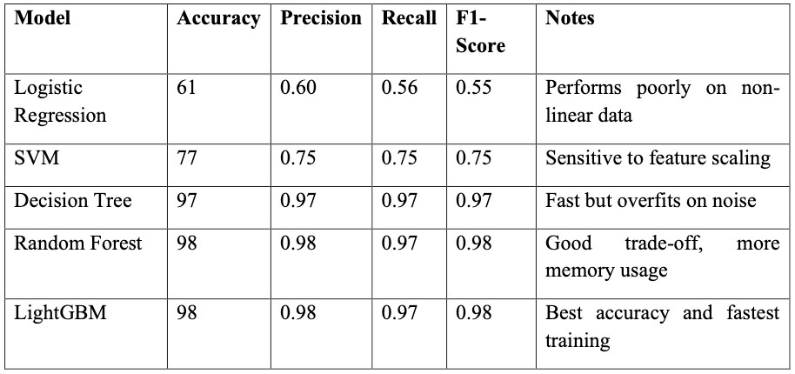
model performance

Slide 17
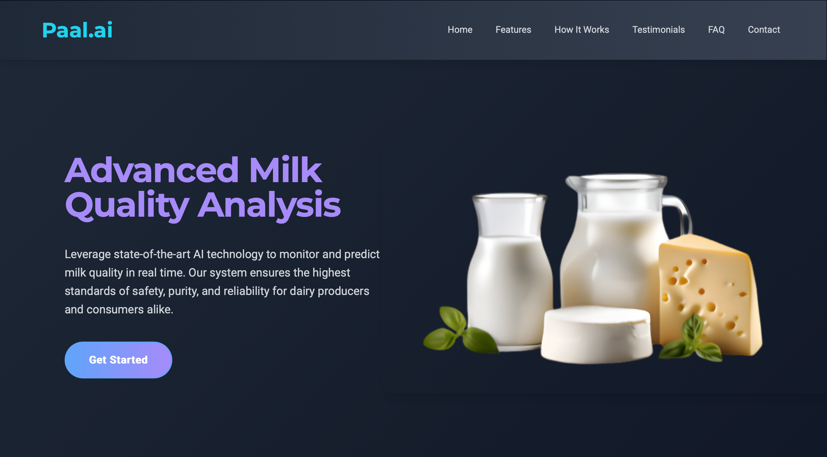
Webpage for deployment

Slide 18
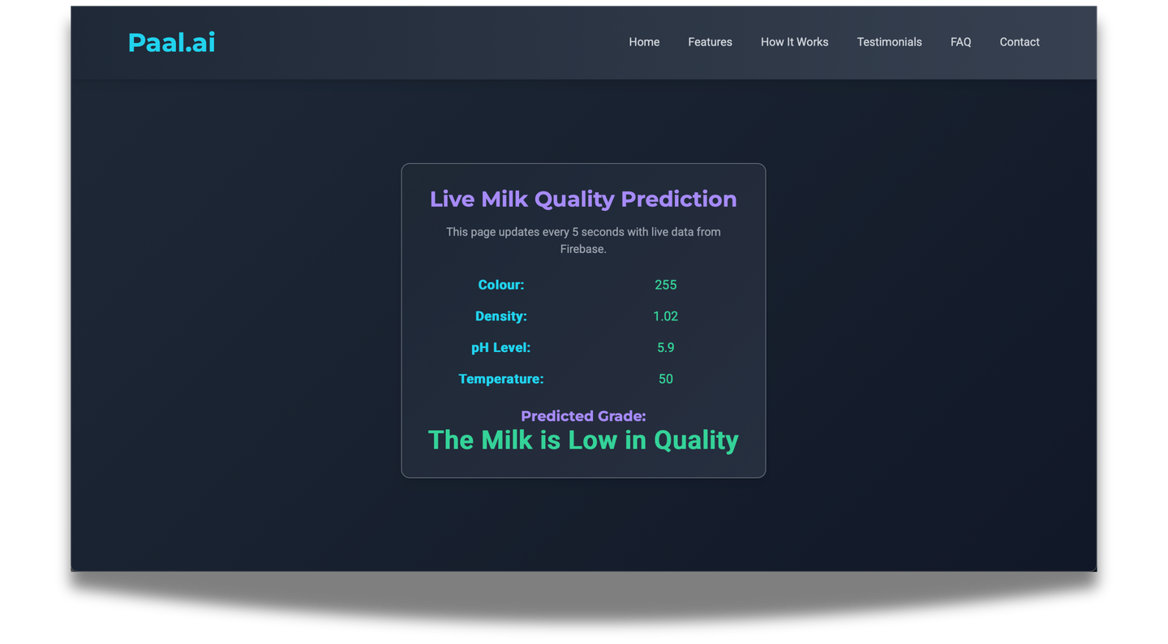
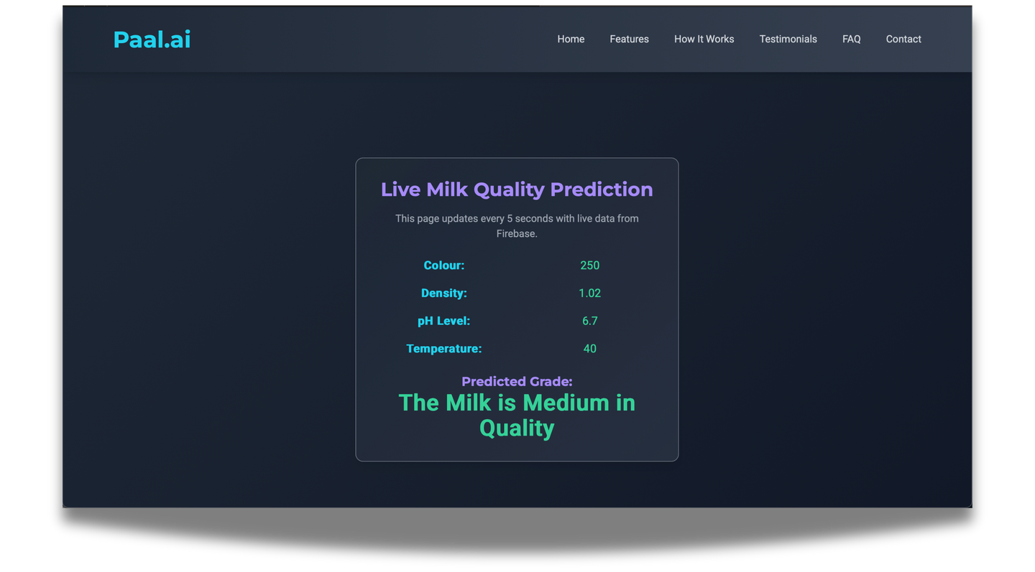
results from deployment

Slide 19
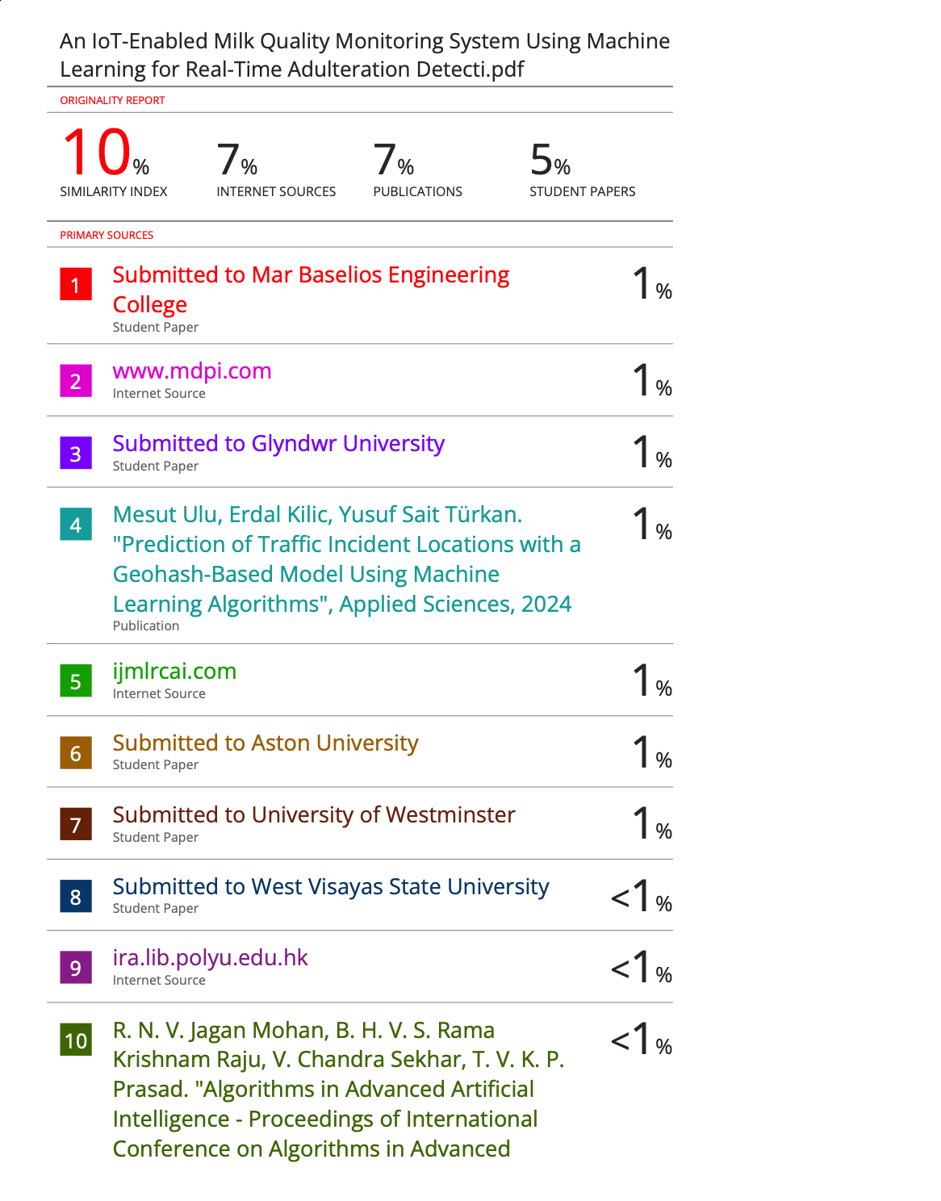




Plagiarism report & Certificates

Slide 20
Outcome & Paper Details
Accurate identification of milk spoilage and adulteration.
Affordable and accessible solution for small-scale dairy producers.
Promotes sustainable dairy practices.
Ensures food safety compliance.
Paper is Accepted at ICRETM2025
Paper Id: ICRETM251236
Selected Journal: Indonesian Journal of Science and Technology (ISSN: 2528-1410, (SCOPUS Indexed)

Slide 21
THANK YOU

